Slide 1
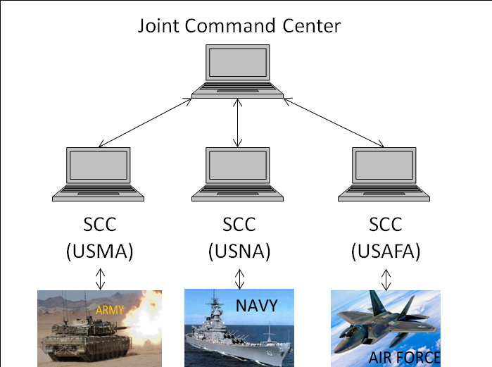
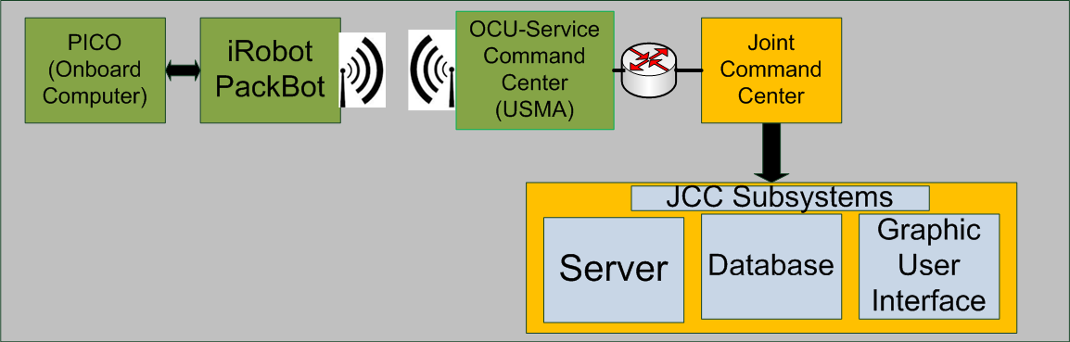
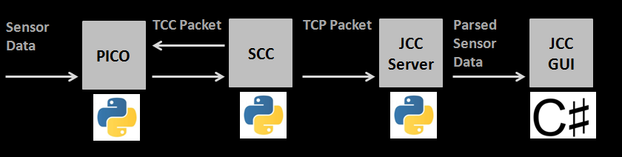
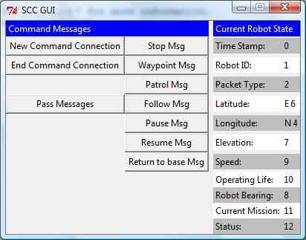
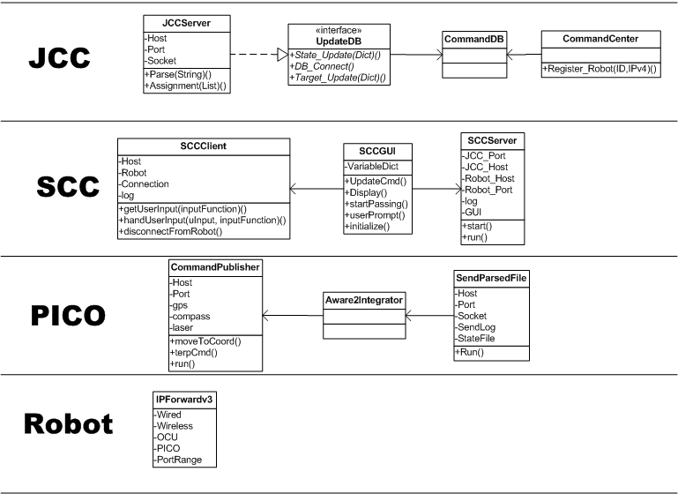
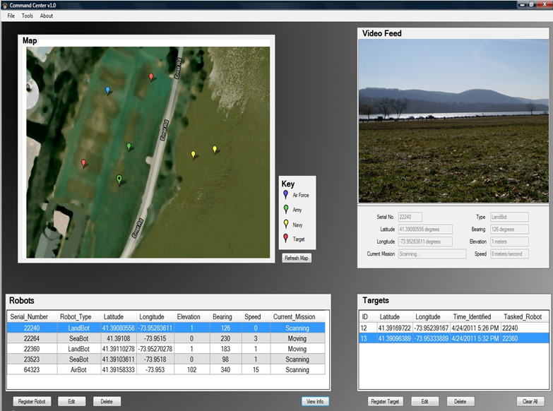
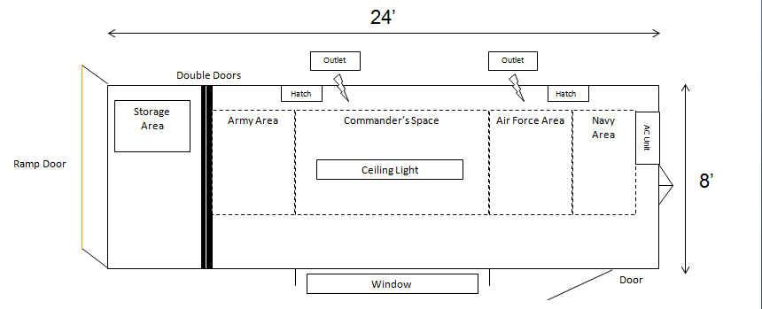
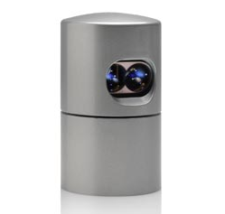
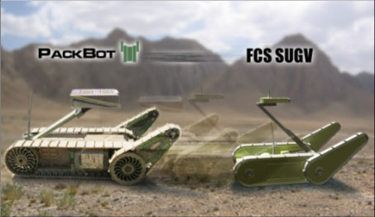
Joint Command Center/Service Command Centers
Above: The diagrams at the top shows the general flow of communication within the system from the USMA perspective up to the Joint Command Center. The diagram just below then shows the flow of messages or information within the USMA specific system as it is collected , passed, and finally parsed into useful information for all service operators.
Right: The USMA Service Command Center, Graphic User Interface (GUI) provides the USMA operator with various options to communicate, monitor, initiate, and end functions with the PackBot.
Above : The diagram above shows the system breakdown of command and control for each service and the overview of the communication of each individual platform.
Below: The diagram below is the class diagram that breaks down how messages are passed up and down starting with the PackBot, traveling up to the JCC, back down to the SCC, and using that information to allow the operator to make decisions.
To the left is the Joint Command Center, Graphic User Interface. The GUI shows the three service operators the locations of the various platforms (enemy and friendly) in the area of operations (both visual and grid location), current platform status, and the camera feed of the selected platform.
Joint Cooperative Unmanned Systems Initiative: Future Work
Future Layout of the “Mobile Joint Command Center”
Future Hardware
The layout above is the desired solution for the future Joint Command Center. Utilizing a customized trailer will allow for JCUSI to be mobile rather than the current use of a stationary ground command center. This presents an opportunity to respond to situational needs in many different locations.
Future Project Work:
Target Identification- Use of image processing techniques combined with thermal cameras, LIDAR data, and/or other sensor information to identify targets.
Multiple Robots- Use multiple PackBots, SUGVs, etc. using one operator control unit to provide more ground security than just a single robot.
General Improvements to be made:
-JCC functionality, add directives
-SCC interface: include higher level perspective
-Video to JCC
-Stand alone map: DTED, Buckeye (LIDAR/Imagery)
-Expanded SCC command set/functionality
-Improvement of Autonomous Navigation
Top: Pictured at the top is the Velodyne Lidar. This future JCUSI component has already been acquired and is on track for implementation for the 2013 JCUSI Platform.
Bottom: The current platform in use is the PackBot, but future work will be focused on implementing the JCUSI package on the SUGV which is smaller, lighter, and more mobile.

Slide 2





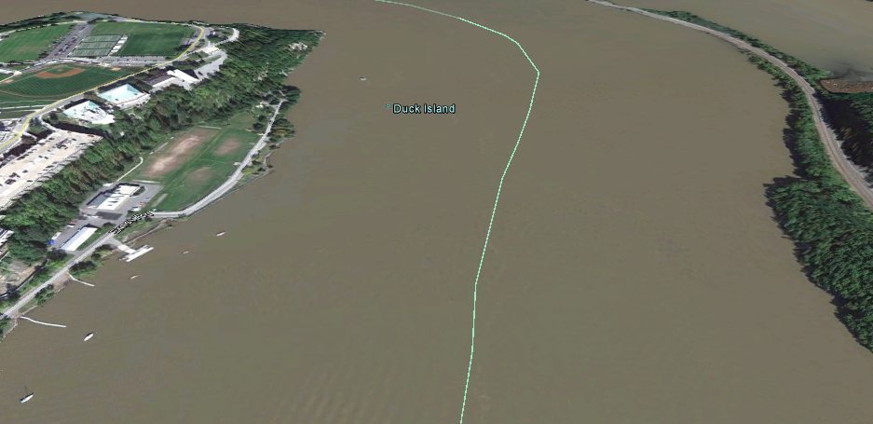
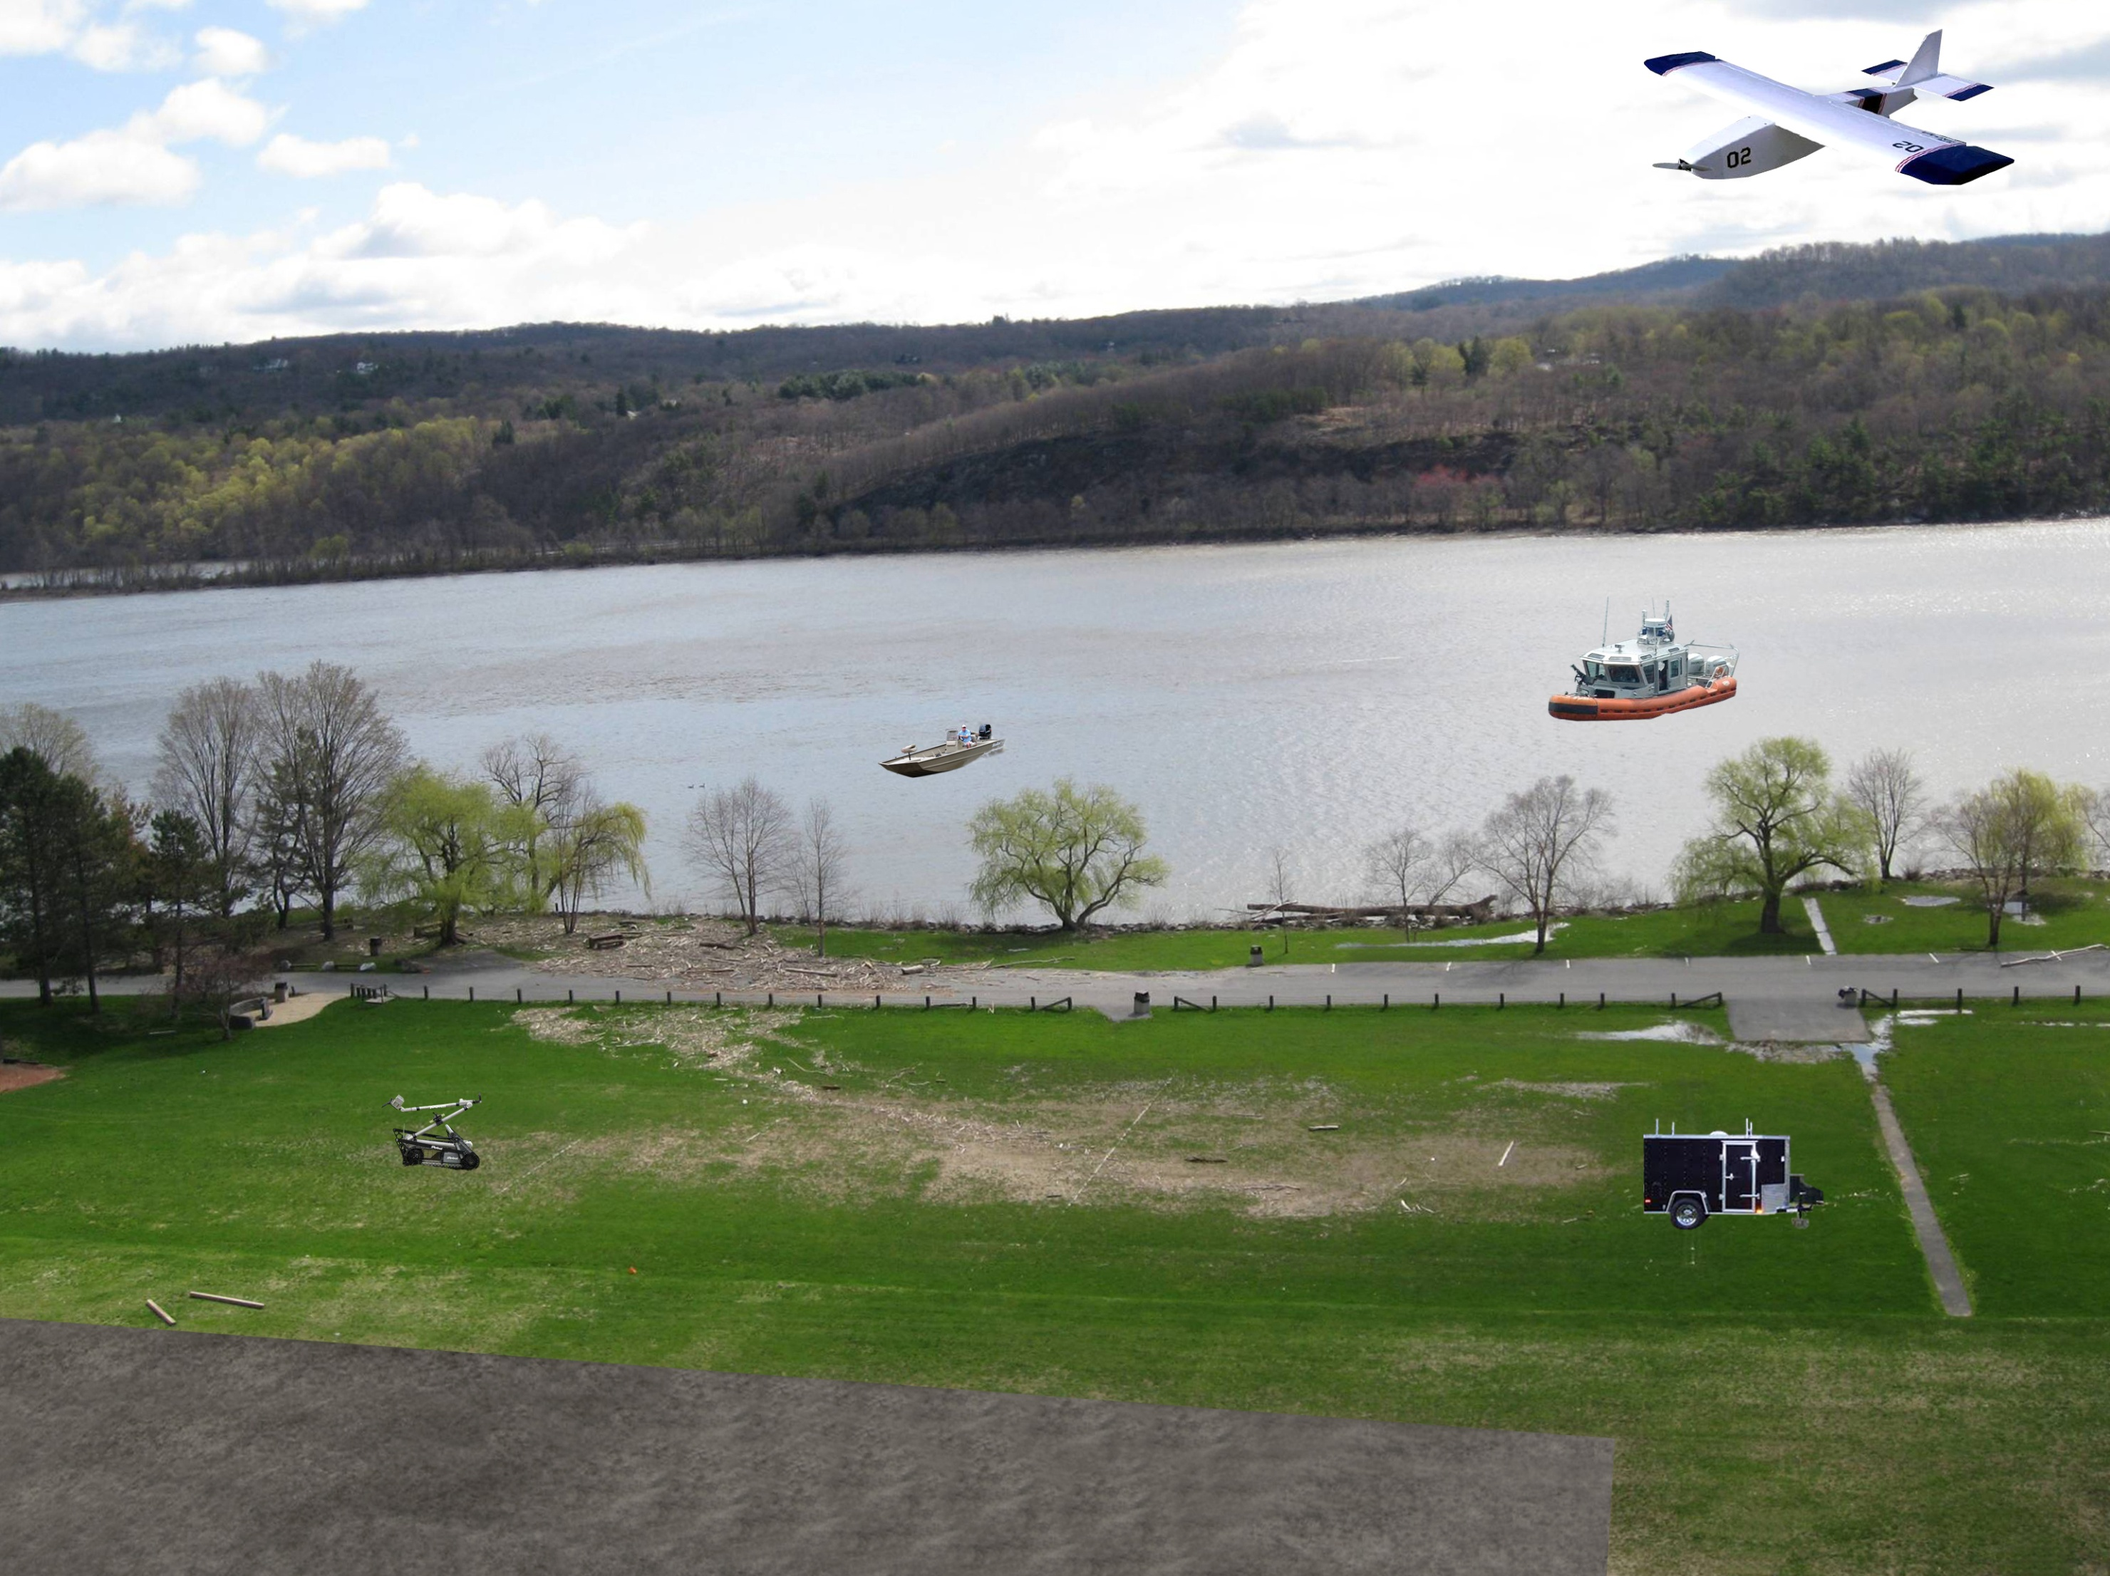


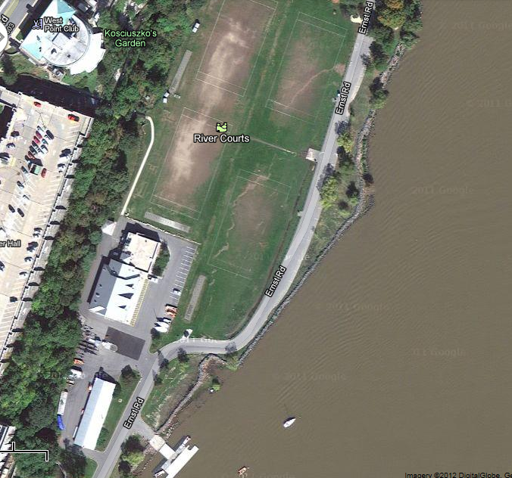


Joint Cooperative Unmanned Systems Initiative
CDTs Justin Bucher (IT), John Fernandes (CS), Patrick Hammond (EM), Greg Hurlock (EE), Fang Liu (CS), Sam Lough (CS), Grace Lu (EE), Chris Nelson (IT), Grigoriu Rus (EE), Anthonio Saw (EE), Nick Starck-King (EE)
COL Robert Sadowski, LTC Paul Maxwell, MAJ Dominic Larkin, and MAJ Christopher Lowrance
Overall Problem Statement:
Develop a network of aerial (USAFA), naval (USNA), and land (USMA) semi-autonomous robots that share operational data through a Joint Command Center (JCC) to collectively reconnoiter a region and/or track a designated target.
West Point Specific Problem Statement:
Develop two ground robots that will be able to detect, locate, and advance on a designated target as directed by a Service Command Center (SCC) and provide current status information to a Joint Command Center in order to provide a joint service common operating picture.
Why JCUSI?
The Joint Cooperative Unmanned Systems Initiative exemplifies the importance of autonomous systems in the future of both combat and security operations. The goal of the autonomous system and their utilization, is to take the human risk factor out of the operating environment while acting as a force multiplier. The future of JCUSI will show that one user, operating the Joint Command Center, will be able to provide guidance and oversight to complete a mission that in the past would have required many different operators and assets. JCUSI is the future of unmanned combat and security, putting expendable systems between our friendly operators and the enemy.
Area of Operations
JCC=Joint Command Center
SCC=Service Command Center
USAFA=United States Air Force Academy
USMA=United States Military Academy
USNA=United States Naval Academy
=Wireless Communication
Top: The diagram above shows our defined area operations specific to our scenario. The red lines identify our limits of advance for the three service platforms on water, land, and air.
Left: Overall system diagram displays the basic layout of the scenario in the actual location the demo will be executed.
Bottom: Diagram shows current location and the location for the demonstration of the JCUSI scenario.
U
S
A
F
A
Target
Runway
U
S
N
A
Morning Presentation Location
SCC
SCC
Joint Command Center and Viewing Area for demonstration
USMA
SCC
JCC
UAV Runway
Launch for boats

Slide 3
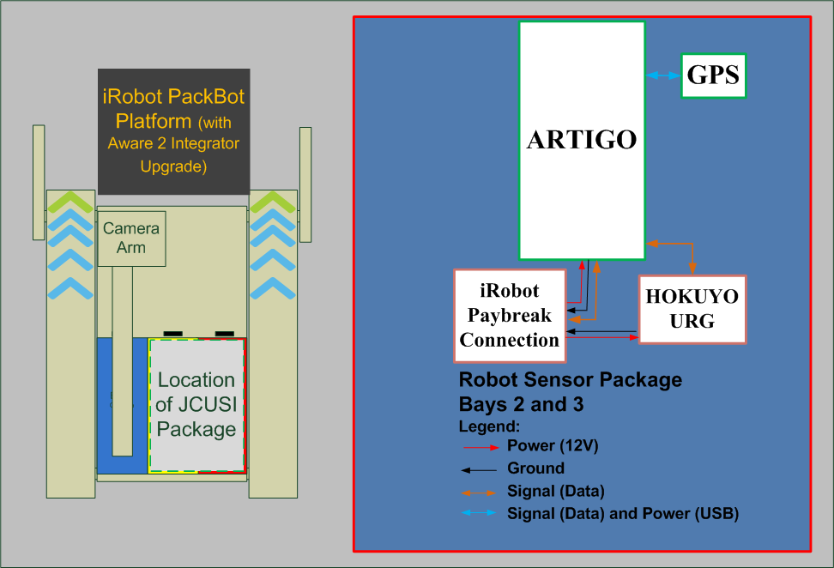
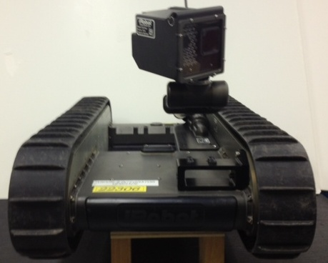
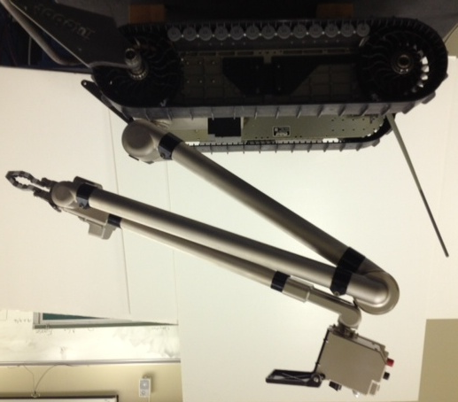
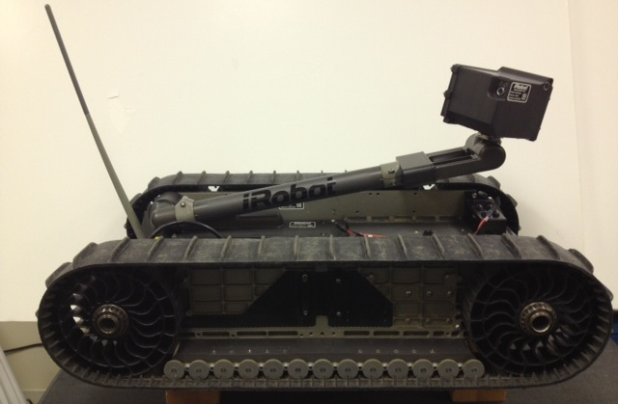
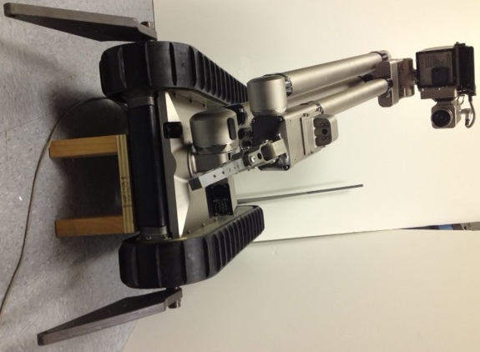
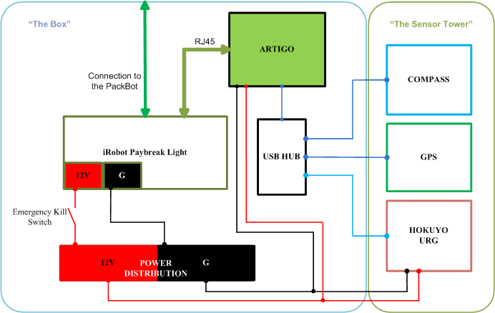
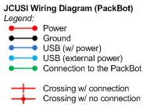
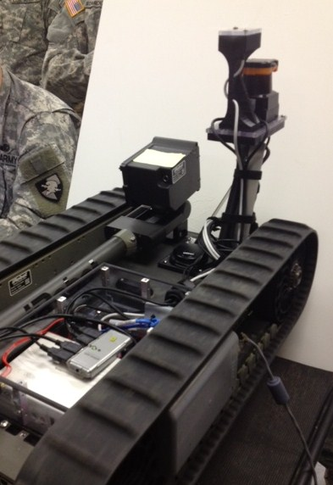
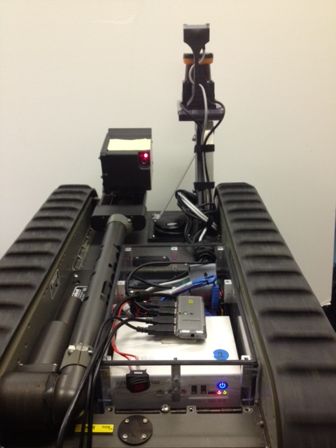
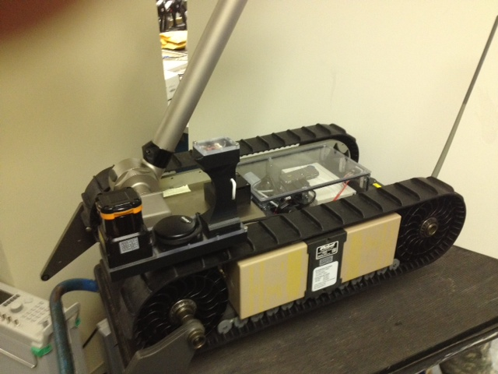
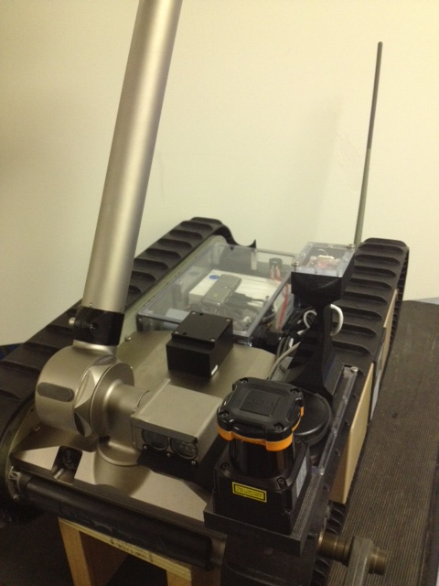
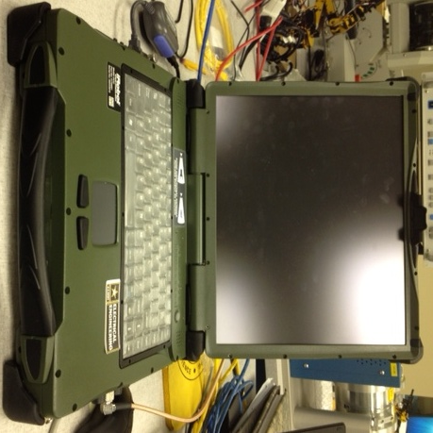
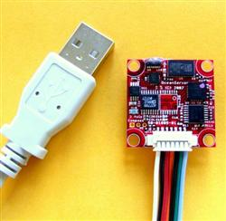
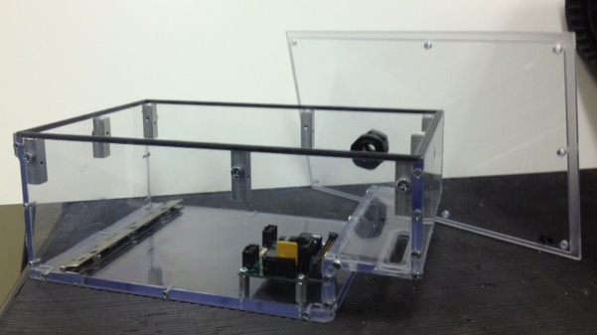
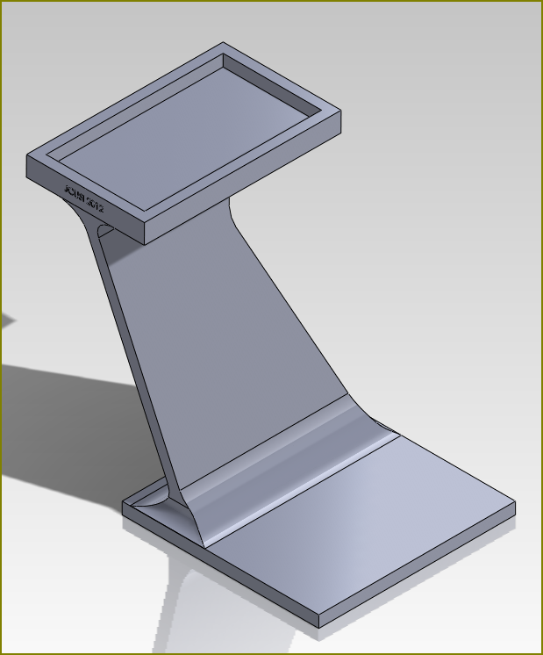
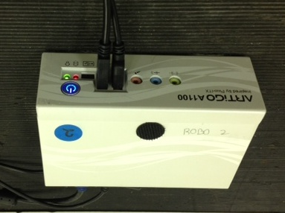
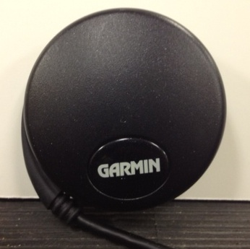
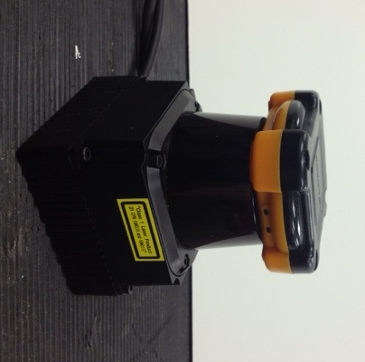
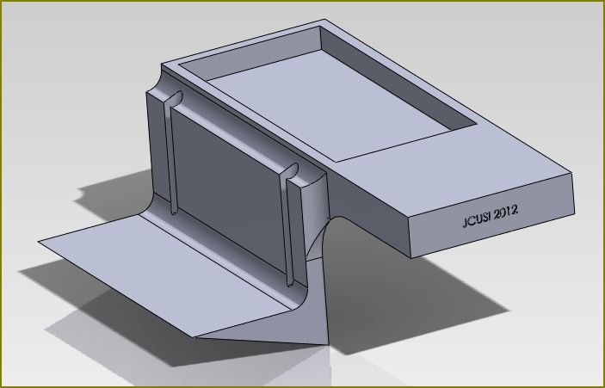
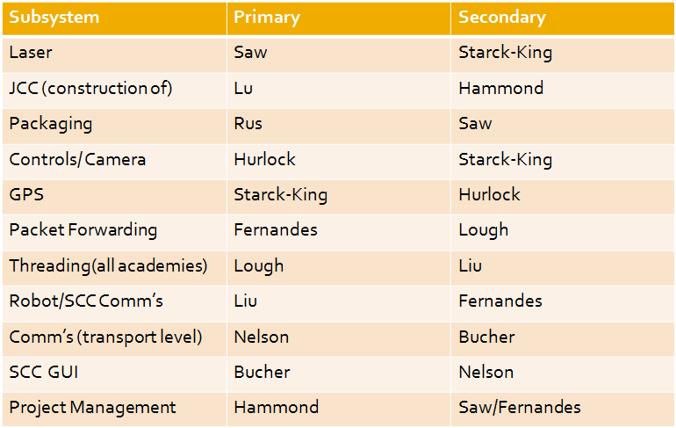
iRobot PackBot
System Diagram of JCUSI-Modified PackBot
JCUSI Package
PackBots BEFORE Modifications
PackBot Radio
PackBot Aware2
(Pico-Mini Computer Running ROS)
PackBot 1
PackBot 2
PackBots AFTER Modifications
PackBot 1
PackBot 1 contains the JCUSI Package as well as a its very own custom sensor tower. The sensor tower contains the Hokoyu laser, compass, and GPS. The photos of PackBot 1 shows the contents of the JCUSI package with the water resistant top removed so the contents may be viewed.
PackBot 2 contains the JCUSI Package as well as its very own custom sensor tower. The sensor tower contains the Hokoyu laser, compass, and GPS. It contains the same JCUSI Package as PackBot 1, but the water resistant top is replaced to show full enclosure.
PackBot 2
Hardware
Operator Control Unit
Cameras
Compass
Custom Mounts and Packaging
Water-Resistant Packaging
PackBot 1: Mount for Laser, Compass and GPS
Artigo Pico
Garmin GPS
Hokoyu Laser
PackBot 2: Mount for Laser, Compass, and GPS
Responsibility Matrix and Major Project Milestones
Major Milestones
Complete- 23 January 2012: Service meeting (USAFA,USNA, and USMA) to finalize specifications for JCUSI project
Complete- 08 March 2012: All subsystems complete and ready for integration (Laser, Packaging, Controls/Camera, GPS, Packet Forwarding, Threading, Communications, SCC GUI)
Complete- 23 April-02 May 2012: Final Testing (Demo runs, Final Film and presentation materials complete, Scenario site prepared for demo)
03 May 2012: Projects Day (Final Product Presentation and Live Demonstration for stakeholders by USAFA, USMA, and USNA)

